Slide 1
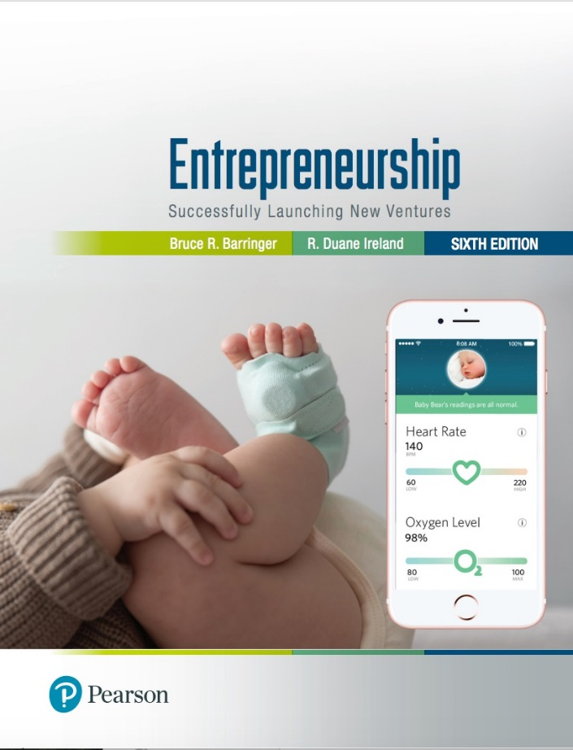
Entrepreneurship: Successfully Launching New Ventures
Sixth Edition
Chapter 3
Feasibility Analysis
Notes:
If this PowerPoint presentation contains mathematical equations, you may need to check that your computer has the following installed:
1) MathType Plugin
2) Math Player (free versions available)
3) NVDA Reader (free versions available)

Slide 2
Learning Objectives (1 of 2)
3.1 Explain what a feasibility analysis is and why it’s important.
3.2 Describe a product/service feasibility analysis, explain its purpose, and discuss the two primary issues that a proposed business should consider in this area.
3.3 Describe an industry/market feasibility analysis, explain its purpose, and discuss the two primary issues to consider when completing this analysis.

Slide 3
Learning Objectives (2 of 2)
3.4 Explain what an organizational feasibility analysis is and its purpose and discuss the two primary issues to consider when completing this analysis.
3.5 Describe what a financial feasibility analysis is, explain its importance, and discuss the most critical issues to consider when completing this analysis.
3.6 Describe a feasibility analysis template and explain when it is important for entrepreneurs to use this template.

Slide 4
What Is Feasibility Analysis?
Feasibility Analysis
Feasibility analysis is the process of determining whether a business idea is viable.
It is the preliminary evaluation of a business idea, conducted for the purpose of determining whether the idea is worth pursuing.

Slide 5
When to Conduct a Feasibility Analysis
Timing of Feasibility Analysis
The proper time to conduct a feasibility analysis is early in thinking through the prospects for a new business.
The thought is to screen ideas before a lot of resources are spent on them.
Components of a Properly Conducted Feasibility Analysis
A properly conducted feasibility analysis includes four separate components, as discussed in the following slides.

Slide 6
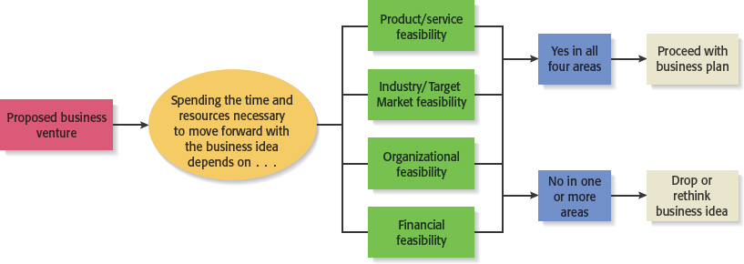
Feasibility Analysis
Figure 3.1 Role of Feasibility Analysis in Developing Successful Business Ideas

Slide 7
Forms of Feasibility Analysis
Product/Service Feasibility
Industry/Target Market Feasibility
Organizational Feasibility
Financial Feasibility

Slide 8
Outline for a Comprehensive Feasibility Analysis
Table 3.1 Feasibility Analysis
Part 1: Product/Service Feasibility
Product/service desirability
Product/service demand
Part 2: Industry/Target Market Feasibility
Industry attractiveness
Target market attractiveness
Part 3: Organizational Feasibility
Management prowess
Resource sufficiency
Part 4: Financial Feasibility
Total start-up cash needed
Financial performance of similar businesses
Overall financial attractiveness of the proposed venture
Overall Assessment

Slide 9
Product/Service Feasibility Analysis (1 of 2)
Purpose
Is an assessment of the overall appeal of the product or service being proposed.
Before a prospective firm rushes a new product or service into development, it should be sure that the product or service is what prospective customers want.

Slide 10
Product/Service Feasibility Analysis (2 of 2)
Components of product/service feasibility analysis
Product/Service Desirability
Product/Service Demand

Slide 11
Product/Service Desirability (1 of 3)
First, ask the following questions to determine the basic appeal of the product or service.
Does it make sense? Is it reasonable? Is it something consumers will get excited about?
Does it take advantage of an environmental trend, solve a problem, or take advantage of a gap in the marketplace?
Is this a good time to introduce the product or service to the market?
Are there any fatal flaws in the product or service’s basic design or concept?

Slide 12
Product/Service Desirability (2 of 3)
Second, Administer a Concept Test
A concept statement should be developed.
A concept statement is a one-page description of a product or service idea that is distributed to people who are asked to provide feedback on the potential of the idea.
The feedback will hopefully provide the entrepreneur:
A sense of the viability of the product or service idea.
Suggestions for how the idea can be strengthened or “tweaked” before proceeding further.

Slide 13
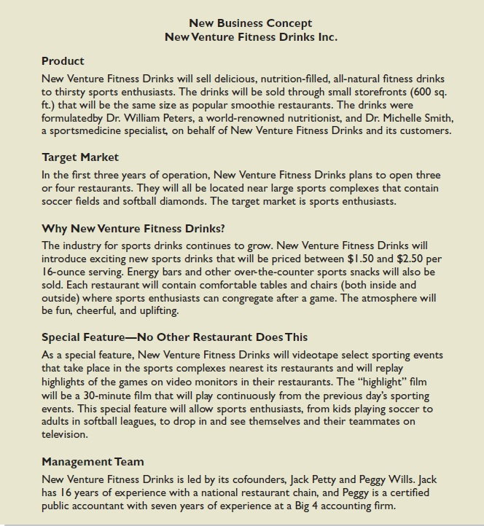
Product/Service Desirability (3 of 3)
Figure 3.2 New Venture Fitness Drinks’ Concept Statement

Slide 14
Product/Service Demand (1 of 10)
There are three steps to assessing product/service demand.
Step 1: Talking Face-to-Face with Potential Customers
Step 2: Using Online Tools
Step 3: Library, Internet and Gumshoe Research

Slide 15
Product/Service Demand (2 of 10)
Step 1: Talking Face-to-Face with Potential Customers
The only way to know if your product or service is what people want is by talking to them.
The idea is to gauge customer reaction to the general concept of what you want to sell, and then tweak, revise, and improve on the idea based on the feedback.
In some cases, talking with potential customers will cause an entrepreneur to abandon an idea.
Entrepreneurs are often surprised to find that a product idea they think solves a problem gets lukewarm reception when they talk to actual customers.

Slide 16
Product/Service Demand (3 of 10)
Step 2: Utilizing Online Tools
The second way to assess demand is to utilize online tools to gauge reaction from potential customers.
Online tools include the following:
Administrating surveys
Querying Q&A sites
Utilizing Google Trends
Purchasing Google AdWords to direct users to landing pages to see how many people request additional information.

Slide 17
Product/Service Demand (4 of 10)
Surveys and Q&A Sites
Surveys can be generated and easily administered via web sites like Survey Monkey.
Surveys are most effective in validating what you’ve learned from face-to-face interviews rather than collecting initial data.
Q&A Sites, such as Quora and Bright Journey, can be helpful in assessing product demand.
You might pose a question on a Q&A site such as “Does Chicago need better food delivery services?” The responses may provide insight about demand for food delivery services in Chicago.

Slide 18
Product/Service Demand (5 of 10)
Google Trends
Allows you to enter a search term (such as skiing or running) to see if the term is trending upwards or downwards in Google search queries.
An upward trajectory may indicate strong consumer interest, while a downward trajectory may indicate that consumer interest is waning.

Slide 19
Product/Service Demand (6 of 10)
Google AdWords Coupled With Landing Pages
Some entrepreneurs buy text ads on search engines that show up when a user is searching for a product that is close to their idea.
If the searcher clicks on the text ad, they are taken to a landing page that describes the idea.
There may be a link on the landing page that says “For future updates please enter your e-mail address.” Demand for the idea can be assessed by how many people click on the text ad and enter their e-mail address.

Slide 20
Product/Service Demand (7 of 10)
Step 3: Library, Internet and Gumshoe Research
The third way to assess the demand for a product or service idea is to conduct library, Internet, and gumshoe research.

Slide 21
Product/Service Demand (8 of 10)
Library Research
Library research provides access to archival data, which can provide useful information.
For example, if one were thinking about starting a company to sell educational toys, archival research may answer question such as:
What is the trajectory of the toy industry?
What do industry experts say are the most important factors that parents consider when buying toys?
Is there a trade association for the makers of educational toys that can provide additional information?

Slide 22
Product/Service Demand (9 of 10)
Internet Research
The Internet Resource Table in Appendix 3.3 provides specific recommendations of online resources to utilize.
For example, IBISWorld, which is available for free through most university libraries, provides current industry reports on hundreds of industries.
More general Internet research is also helpful.
Simply typing a query into Google such as “market demand for educational toys” will often produce helpful articles and industry reports.

Slide 23
Product/Service Demand (10 of 10)
Gumshoe Research
Simple gumshoe research is also important for gaining a sense of the likely demand for a product or service idea.
A gumshoe is a detective or an investigator that scrounges around for information or clues wherever they can be found.
Don’t be bashful. Ask people what they think about your product or service idea. If your idea is to sell educational toys, spend a week volunteering at a day care center and watch how children interact with toys. Take the owner of a toy store to lunch and discuss your ideas.

Slide 24
Industry/Target Market Feasibility Analysis (1 of 2)
Purpose
Is an assessment of the overall appeal of the industry and the target market for the proposed business.
An industry is a group of firms producing a similar product or service.
A firm’s target market is the limited portion of the industry it plans to go after.

Slide 25
Industry/Target Market Feasibility Analysis (2 of 2)
Components of industry/target market feasibility analysis
Industry Attractiveness
Target Market Attractiveness

Slide 26
Industry Attractiveness (1 of 2)
Industries vary in terms of their overall attractiveness.
In general, the most attractive industries have the characteristics depicted on the next slide.
Particularly important—the degree to which environmental and business trends are moving in favor rather than against the industry.

Slide 27
Industry Attractiveness (2 of 2)
Characteristics of Attractive Industries
Are young rather than old.
Are early rather than late in their life cycle.
Are fragmented rather than concentrated.
Are growing rather than shrinking.
Are selling products and services that customers “must have” rather than “want to have.”
Are not crowded.
Have high rather than low operating margins.
Are not highly dependent on the historically low price of a key raw material, like gasoline or flour, to remain profitable

Slide 28
Target Market Attractiveness
The challenge in identifying an attractive target market is to find a market that’s large enough for the proposed business but is yet small enough to avoid attracting larger competitors.
Assessing the attractiveness of a target market is tougher than assessing the attractiveness of an entire industry.
Often, considerable ingenuity must be employed to find information to assess the attractiveness of a specific target market.

Slide 29
Organizational Feasibility Analysis (1 of 2)
Purpose
Is conducted to determine whether a proposed business has sufficient management expertise, organizational competence, and resources to successfully launch a business.
Focuses on non-financial resources (financial resources are considered later)

Slide 30
Organizational Feasibility Analysis (2 of 2)
Components of organizational feasibility analysis
Management Prowess
Resource Sufficiency

Slide 31
Management Prowess
A proposed business should candidly evaluate the prowess, or ability, of its management team to satisfy itself that management has the requisite passion and expertise to launch the venture.
Two of the most important factors in this area are:
The passion that the sole entrepreneur or the founding team has for the business idea.
The extent to which the sole entrepreneur or the founding team understands the markets in which the firm will participate.

Slide 32
Resource Sufficiency (1 of 2)
This topic pertains to an assessment of whether an entrepreneur has sufficient resources to launch the proposed venture.
To test resource sufficiency, a firm should list the 6 to 12 most critical nonfinancial resources that will be needed to move the business idea forward successfully.
If critical resources are not available in certain areas, it may be impractical to proceed with the business idea.

Slide 33
Resource Sufficiency (2 of 2)
Examples of nonfinancial resources that may be critical to the successful launch of a new business
Affordable office space.
Lab space, manufacturing space, or space to launch a service business.
Availability of contract manufacturers or service providers.
Key management employees (now and in the future).
Key support personnel (now and in the future).
Ability to obtain intellectual property protection.
Ability to form favorable business partnerships.

Slide 34
Financial Feasibility Analysis (1 of 2)
Purpose
Is the final component of a comprehensive feasibility analysis.
A preliminary financial assessment is sufficient.

Slide 35
Financial Feasibility Analysis (2 of 2)
Components of financial feasibility analysis
Total Start-Up Cash Needed
Financial Performance of Similar Businesses
Overall Financial Attractiveness of the Proposed Venture

Slide 36
Total Start-Up Cash Needed
The first issue refers to the total cash needed to prepare the business to make its first sale.
An actual budget should be prepared that lists all the anticipated capital purchases and operating expenses needed to generate the first $1 in revenues.
The point of this exercise is to determine if the proposed venture is realistic given the total start-up cash needed.

Slide 37
Financial Performance of Similar Businesses
Estimate the proposed start-up’s financial performance by comparing it to similar, already established businesses.
There are several ways to doing this, all of which involve a little ethical detective work.
First, there are many reports available, some for free and some that require a fee, offering detailed industry trend analysis and reports on thousands of individual firms.
Second, simple observational research may be needed. For example, the owners of New Venture Fitness Drinks could estimate their sales by tracking the number of people who patronize similar restaurants and estimating the average amount each customer spends.

Slide 38
Overall Financial Attractiveness of the Proposed Venture (1 of 2)
Overall Financial Attractiveness of the Proposed Investment
A number of other financial factors are associated with promising business start-ups.
In the feasibility analysis stage, the extent to which a business opportunity is positive relative to each factor is based on an estimate rather than actual performance.
The information on the next slide lists the factors that pertain to the overall attractiveness of the financial feasibility of the business idea.

Slide 39
Overall Financial Attractiveness of the Proposed Venture (2 of 2)
Financial Factors Associated With Promising Business Opportunities
Steady and rapid growth in sales during the first 5 to 7 years in a clearly defined market niche.
High percentage of recurring revenue—meaning that once a firm wins a client, the client will provide recurring sources of revenue.
Ability to forecast income and expenses with a reasonable degree of certainty.
Internally generated funds to finance and sustain growth.
Availability of an exit opportunity for investors to convert equity to cash.

Slide 40
A Feasibility Analysis Template
First Screen, shown in Appendix 3.2, is a template for completing a feasibility analysis.
It’s called “First Screen” because it’s a tool that can be used in the initial pass at determining the feasibility of a business idea.
If a business idea cuts muster at this stage, the next step is to complete a business plan.

Slide 41

Copyright

